Slide 1
Risk classification for life insurance
Classification of insurance policy based on several risk factors
sri harsha

Slide 2
Contents
Objective
Feature Engineering
Model Creation
Result and Evaluation

Slide 3
objective
In this dataset, we are provided over a hundred variables describing attributes of life insurance applicants. The task is to predict the "Response" variable for each Id in the test set.
We will do a binary classification by altering the target variable. Based on the attributes of customers, will the life insurance policy be approved or not i.e.yes(1) or no(0).We will turn this Multiclass classification into Binary classification. We are making 0 to 7 as one class (0 - which mean approved with additional terms and conditions or rejected) and 8 as another class (1 - which means approved)

Slide 4
Feature engineering
Data with 126 features, and a Target variable.
Target variable is the risk level, from level 1 to level 8.
Among the 126 features, 60 are categorical, 13 continuous, 53 are discrete.
So the objective is to make a classification of the risk level according to the 126 features.
Most of the features in the data are normalized so we will be performing analysis on some continuous variables and creating new features based on Risk parameters

Slide 5
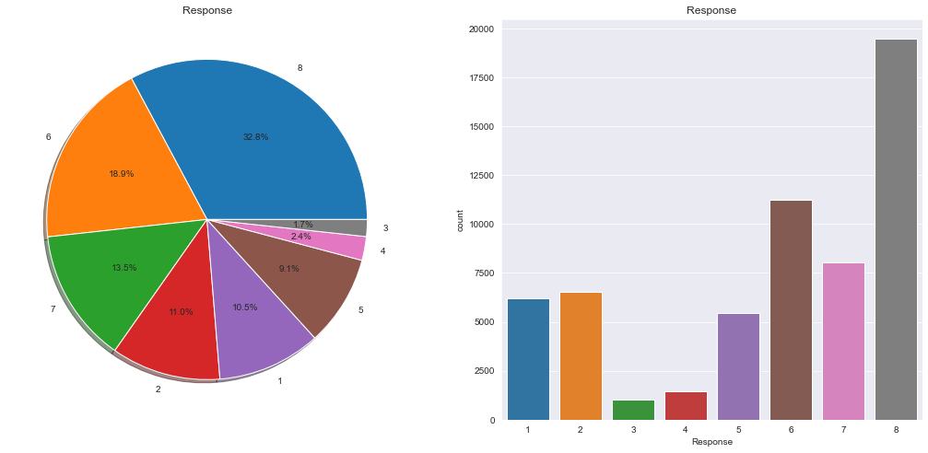
Analysis of response feature
We can see that Class 8 has the highest distribution. We will assume this as clean and accepted policies on standard underwriting terms. Rest other classes can be considered as policies rejected or accepted at extra terms and conditions
We will do a binary classification by altering the response variable. We are making 0 to 7 as one class (0 - rejected or accepted at extra terms and conditions) and 8 (1 - Accepted) as another class

Slide 6
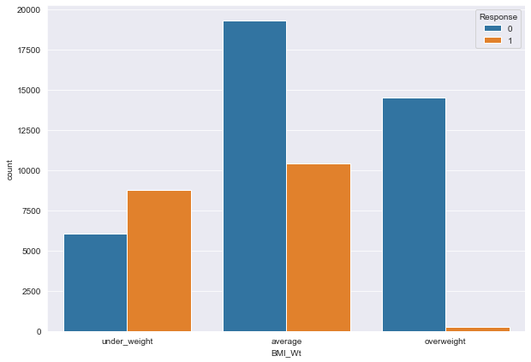
Bmi categorization based on response
Most of the policies for the overweight category people are either rejected or accepted with additional terms and conditions

Slide 7
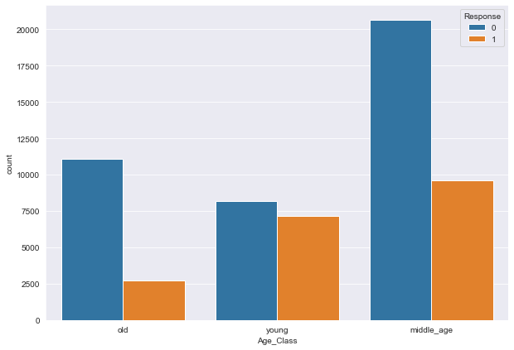
Age categorization based on response
Most of the policies for middle aged and old people are rejected or accepted with additional terms and conditions
Young aged people have high rate of acceptance of policies with standard terms and conditions compared with other age groups

Slide 8
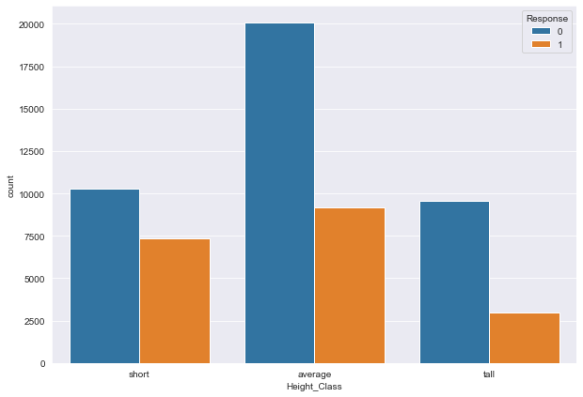
Height categorization based on response
This feature has no consistent behavior with respect to Response variable hence we can drop this feature

Slide 9
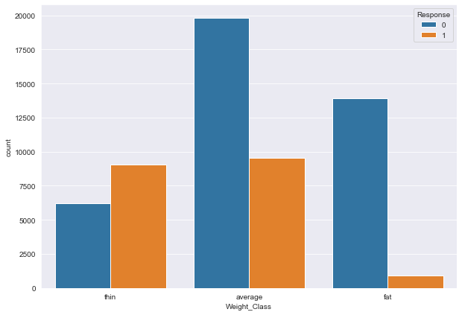
Weight categorization based on response
The policies for people who belong to fat category are either rejected or accepted with additional terms and conditions

Slide 10
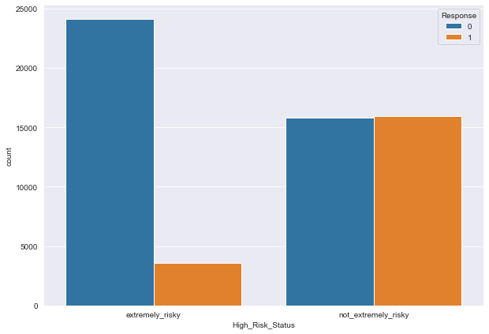
High_Risk_Status categorization based on response
High_Risk_Status is derived based on the below conditions
If BMI_Wt is overweight or Age_Class is Old or Weight_Class is fat we label it as extremely_risky else not_extremely_risky
The policies which are categorized as extremely risky are either rejected or accepted with additional terms and conditions

Slide 11
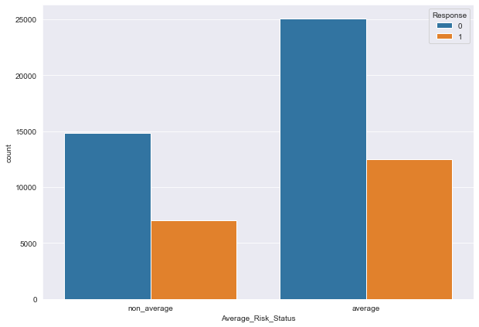
Average_Risk_Status categorization based on response
Average_Risk_Status is derived based on the below conditions
If BMI_Wt is average or Age_Class is average or Weight_Class is average we label it as average else non_average
There is no behaviour that can be extracted from this feature hence this can be dropped

Slide 12
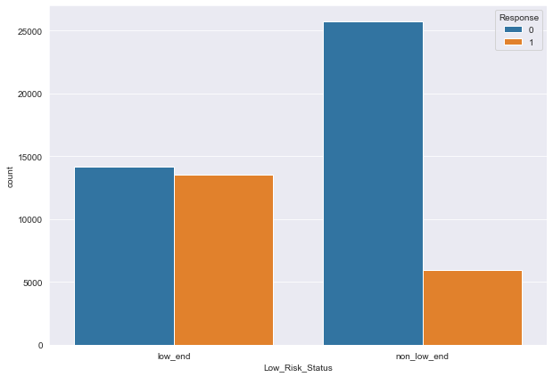
Low_Risk_Status categorization based on response
Low_Risk_Status is derived based on the below conditions
If BMI_Wt is under_weight or Age_Class is young or Weight_Class is thin we label it as low_end else non_low_end
Under non low end risk most of the policies are either rejected or accepted with additional terms and conditions

Slide 13
Model creation
Logistic Regression
Decision Tree
Random Forest
We are using above algorithms to create our model. We will be creating model with default hyperparameters and then we will be tuning these parameters using Randomized and GridSearchCv techniques.

Slide 14
Logistic regression
Logistic Regression is a Machine Learning classification algorithm that is used to predict the probability of a categorical dependent variable. In logistic regression, the dependent variable is a binary variable that contains data coded as 1 (yes, success, etc.) or 0 (no, failure, etc.). In other words, the logistic regression model predicts P(Y=1) as a function of X.
Logistic Regression Assumptions
Binary logistic regression requires the dependent variable to be binary.
The independent variables should be independent of each other. That is, the model should have little or no multicollinearity.
Logistic regression requires quite large sample sizes.

Slide 15
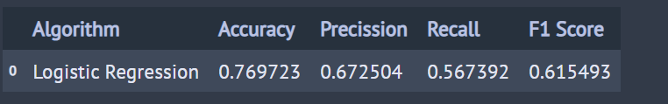
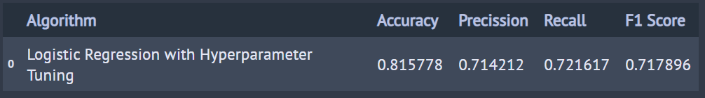
Logistic regression contd…
Below is the performance of Logistic regression model with default hyperparameters
Below s the performance of Logistic regression model after hyperparameters tuning

Slide 16
Decision tree
Decision Trees are a type of Supervised Learning Algorithm. The training data is continuously split into two more sub-nodes according to a certain parameter. The tree can be explained by two things, leaves and decision nodes. The decision nodes are where the data is split. The leaves are the decisions or the final outcomes. You can think of a decision tree in programming terms as a tree that has a bunch of “if statements” for each node until you get to a leaf node (the final outcome).
Decision Tree Pros:
Simple to understand and to interpret
List Requires little data preparation
Decision Tree Cons:
Prone to over-fitting
Decision trees can be unstable (a small variation in the data may result in a completely different tree being generated)

Slide 17
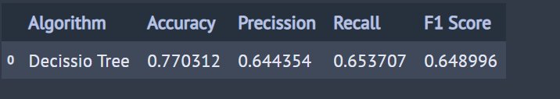
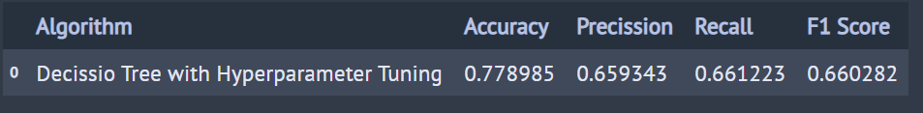
Decision tree contd….
Below is the performance of Decision Tree model with default hyperparameters
Below is the performance of Decision Tree model with hyperparameter tuning

Slide 18
Random forest
Random forest, like its name implies, consists of a large number of individual decision trees that operate as an ensemble. Each individual tree in the random forest spits out a class prediction and the class with the most votes becomes our model’s prediction.
It uses bagging and feature randomness when building each individual tree to try to create an uncorrelated forest of trees whose prediction by committee is more accurate than that of any individual tree.

Slide 19
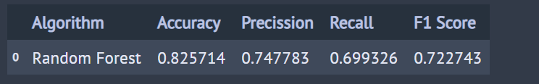
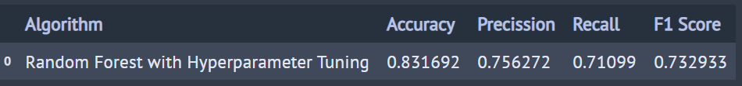
Random forest contd…
Below is the performance of Random Forest model with default hyperparameters
Below is the performance of Random Forest model with hyperparameter tuning

Slide 20
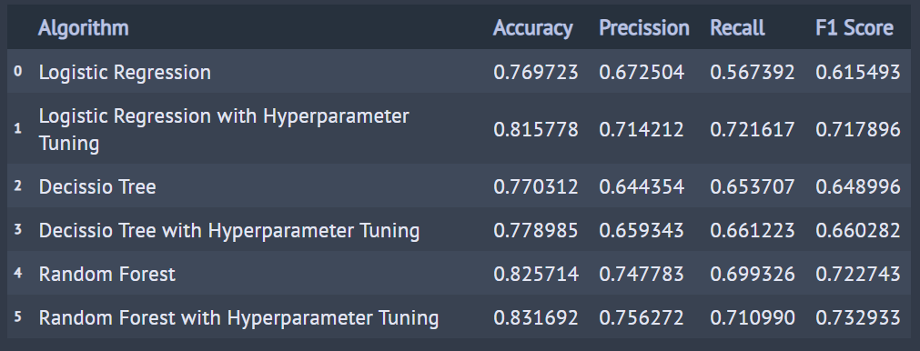
Model comparission
From the below we can see that Random Forest classifer with hyperparameter tuning has given the best performance.

Slide 21
Thank you

